Slide 1
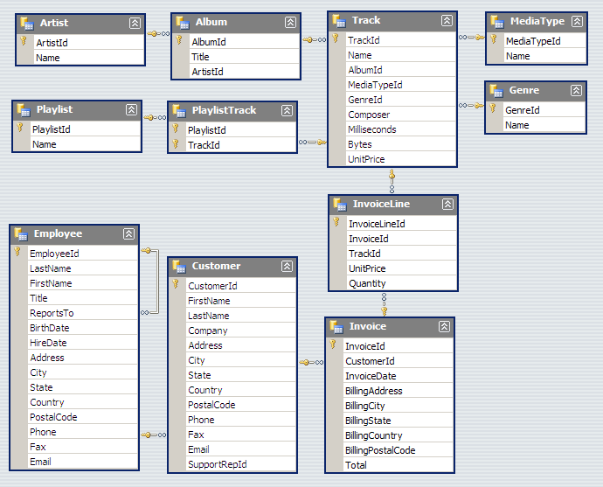
Chinook Database
Notes:
http://chinookdatabase.codeplex.com/wikipage?title=Chinook_Schema

Slide 2
<title>
<visualization>
<description>

Slide 3
<title>
<visualization>
<description>

Slide 4
<title>
<visualization>
<description>

Slide 5
<title>
<visualization>
<description>

